Slide 1
Verification and Testing
Marcela M. Gomez
University of Pittsburgh
School of Computing and Information
mmg62@pitt.edu

Slide 2
ROC (Receiver Operating Characteristic) Curves

Slide 3
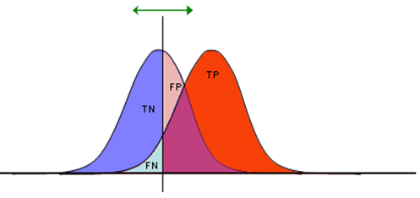
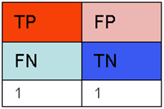
ROC curve (the common sense)
Very often we need to make a compromise between sensitivity and specificity: Higher sensitivity means lower specificity and vice versa.
Setting the threshold is a matter of decision.
The threshold that we decide to adopt will determine the parameters of our test (i.e., true/false positive and true/false negative rates).
http://en.wikipedia.org/wiki/Receiver_operating_characteristic

Slide 4
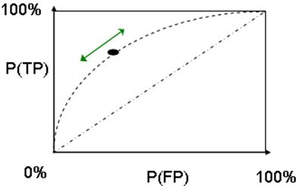
ROC curve (the common sense)
As we move the threshold, we change the values of sensitivity and specificity. The plot of all possible values of these two parameters gives us an interesting characterization of the test (classification system, receiver, etc.)
http://en.wikipedia.org/wiki/Receiver_operating_characteristic

Slide 5
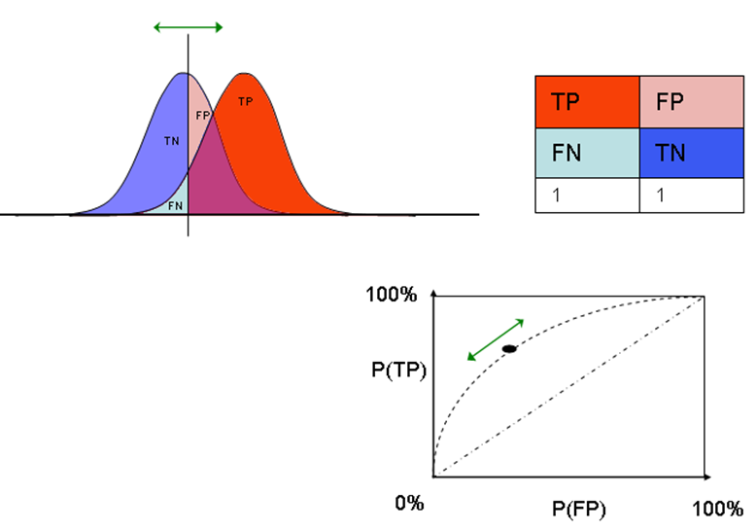
ROC curve (the common sense)
Plots like the one on the right-hand side are called ROC (Receiver Operating Characteristics) Curves
They are a way of characterizing the quality of the detection system
http://en.wikipedia.org/wiki/Receiver_operating_characteristic

Slide 6
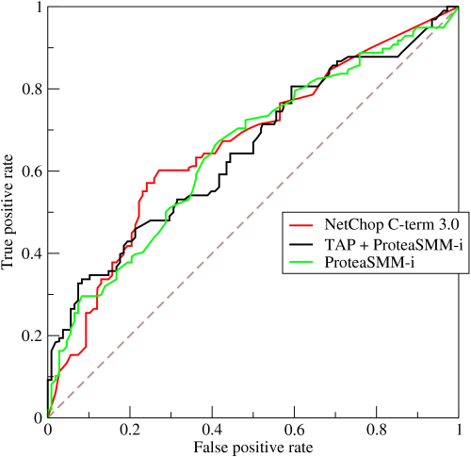
ROC curve
Originates from the signal detection theory
A graphical plot that illustrates the performance of a binary classifier system as its discrimination threshold is varied.
Created by plotting the fraction of true positives out of the positives (TPR = true positive rate) vs. the fraction of false positives out of the negatives (FPR = false positive rate), at various threshold settings. TPR is also known as sensitivity, and FPR is one minus the specificity or true negative rate.
http://en.wikipedia.org/wiki/Receiver_operating_characteristic

Slide 7
AUC: Area Under the (ROC) Curve

Slide 8
AUC: Area Under the (ROC) Curve
AUC is a way of characterizing a “receiver” by means of one number
It captures the intuitive idea that an ROC that is higher is better.
A perfect ROC curve will go through the point (0,1). The area under it will be 1.0.
http://en.wikipedia.org/wiki/Receiver_operating_characteristic

Slide 9
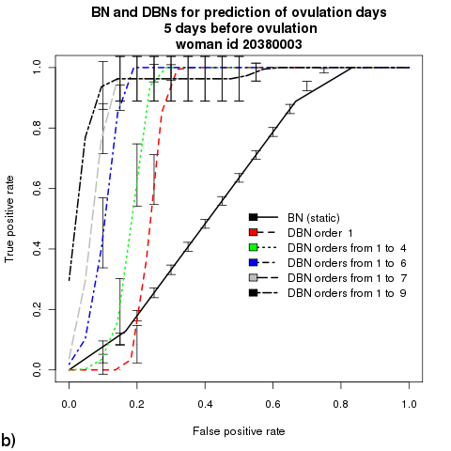
AUC: Area Under the (ROC) Curve
AUC does not always indicate the best model

Slide 10
Verification and Testing
Marcela M. Gomez
University of Pittsburgh
School of Computing and Information
mmg62@pitt.edu

Slide 11
Calibration

Slide 12
Elements of decision theory
The theoretically sound way of making decisions under uncertainty
We need to consider uncertainty and preferences. These are measured in terms of probability and utility respectively.
Probability is a measure of uncertainty.
Utility is a measure of preference that combines with probability as mathematical expectation.

Slide 13

Example decision
http://www.chicagotribune.com/news/weather/90714544-157.html
Should we carry an umbrella?
When is the forecast good?

Slide 14
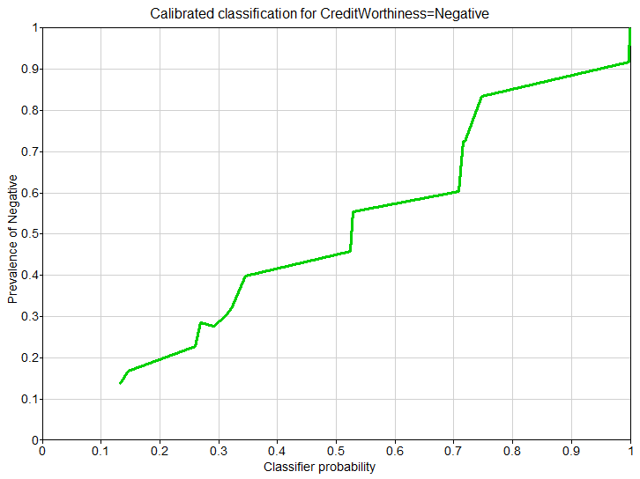
Calibration
The question here is: Is my model producing accurate probabilities?
We plot the frequencies observed in the data (y axis) against the probabilities calculated by the system (x axis).
Various tricks to smoothen out the curve.

Slide 15
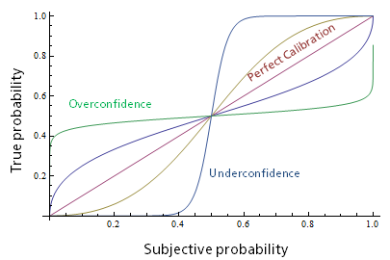
Calibration: Overconfidence and Under-confidence
http://3.bp.blogspot.com/-lmpGS0cqvuw/VDxhem5qTFI/AAAAAAAAACU/qu0hVUn9PBQ/s1600/20141014-Calibration.png

